Slide 1



Ranked 52nd University in India

Slide 2
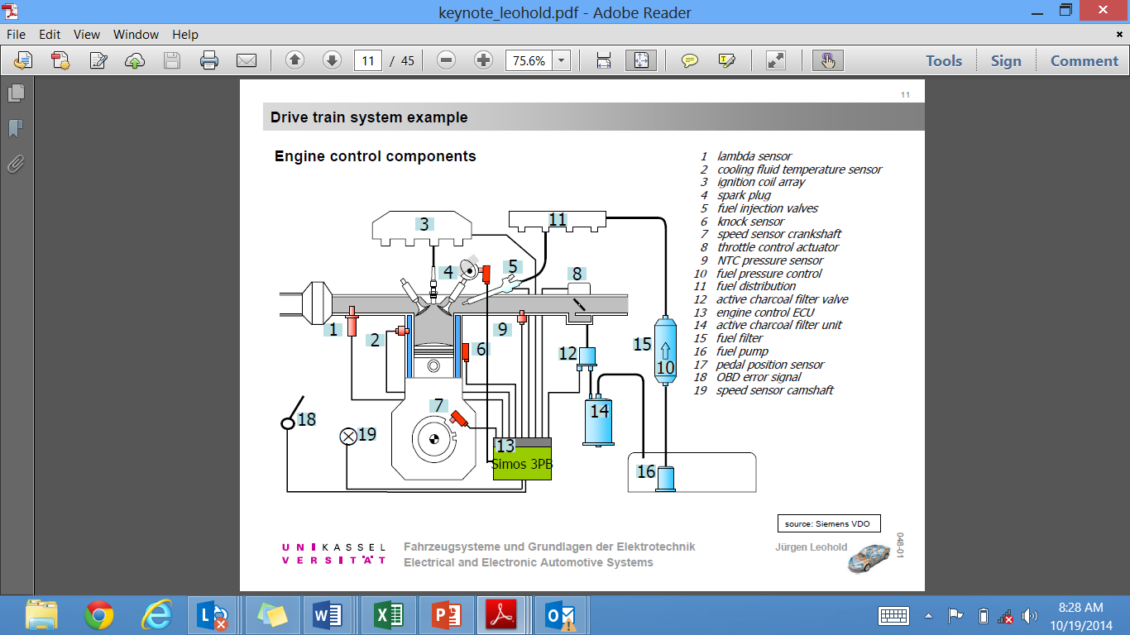
Embedded Applications 1
Subject: Microprocessors and Embedded Systems
Faculty: Dr. Roushan Kumar

Slide 3
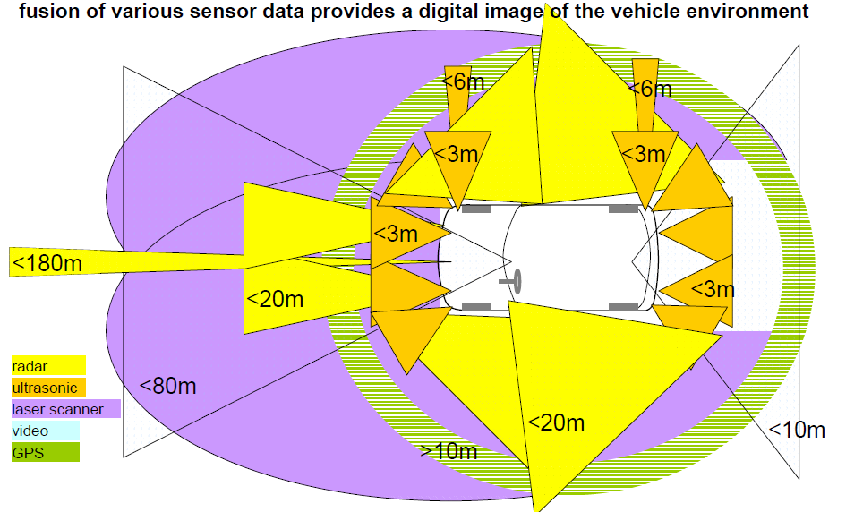
Embedded Applications 2
Envisioning the Accident Avoidance Cars

Slide 4
Content (Unit 1)
Number System: Binary and Hexadecimal;
Combinational Circuits: Adder, Subtractor, Encoder-Decoder;
Sequential Circuits: Flip-Flops, Register and Counters;
Von Neumann Architecture, Computer Types, Functional Units,
Memory System RAM, ROM, Cache, VM, etc.,
Design of Basic Computer.

Slide 5
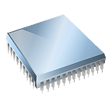
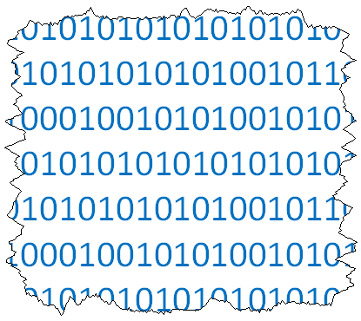
What, More Number Systems?
Why do we need more number systems?
Humans understand decimal
Digital electronics (computers) understand binary
Since computers have 32, 64, and even 128 bit busses, displaying numbers in binary is cumbersome.
Data on a 32 bit data bus would look like the following:
0110 1001 0111 0001 0011 0100 1100 1010
Hexadecimal (base 16) and octal (base 8) number systems are used to represent binary data in a more compact form.
This presentation will present an overview of the process for converting numbers between the decimal number system and the hexadecimal & octal number systems.
Check out my ten digits !
Notes:
In general, a bus is a common ire or parallel group of wires connecting multiple circuits. A data bus is a way of transferring data within and outside a computer.

Slide 6
Converting To and From Decimal
Decimal₁₀
Successive
Division
0 1 2 3 4 5 6 7 8 9
Weighted
Multiplication
Weighted
Multiplication
Successive
Division
Successive
Division
Weighted
Multiplication
Octal₈
Hexadecimal₁₆
0 1 2 3 4 5 6 7
0 1 2 3 4 5 6 7 8 9 A B C D E F
Binary₂
0 1
Notes:
This slide first presents a graphical overview of the process for converting between DECIMAL↔BINARY (students should know how to do this) and then generalizes this process for converting between DECIMAL↔OCTAL & DECIMAL↔HEXADECIMAL.

Slide 7
Counting . . . 2, 8, 10, 16
Decimal |  | Binary |  | Octal |  | Hexadecimal
0 |  | 00000 |  | 0 |  | 0
1 |  | 00001 |  | 1 |  | 1
2 |  | 00010 |  | 2 |  | 2
3 |  | 00011 |  | 3 |  | 3
4 |  | 00100 |  | 4 |  | 4
5 |  | 00101 |  | 5 |  | 5
6 |  | 00110 |  | 6 |  | 6
7 |  | 00111 |  | 7 |  | 7
8 |  | 01000 |  | 10 |  | 8
9 |  | 01001 |  | 11 |  | 9
10 |  | 01010 |  | 12 |  | A
11 |  | 01011 |  | 13 |  | B
12 |  | 01100 |  | 14 |  | C
13 |  | 01101 |  | 15 |  | D
14 |  | 01110 |  | 16 |  | E
15 |  | 01111 |  | 17 |  | F
16 |  | 10000 |  | 20 |  | 10
17 |  | 10001 |  | 21 |  | 11
18 |  | 10010 |  | 22 |  | 12
19 |  | 10011 |  | 23 |  | 13
Notes:
This slide lists the first twenty numbers in each of the four number systems (decimal, binary, octal, hexadecimal).
This is the first time that students will have see A, B, C, D, E, & F used in a “number” system. Remember from Unit 1 that a number system uses its number of symbols to designate values. Base 16 needs 16 unique symbols; 10 is not a unique symbol, it is two. Therefore, the letter A is used to stand for 10, B for 11, and so on.

Slide 8
Review: Decimal ↔ Binary
Base₁₀
DECIMAL
Base₂
BINARY
Successive
Division
Divide the decimal number by 2; the remainder is the LSB of the binary number.
If the quotation is zero, the conversion is complete. Otherwise repeat step (a) using the quotation as the decimal number. The new remainder is the next most significant bit of the binary number.
Base₂
BINARY
Base₁₀
DECIMAL
Weighted
Multiplication
Multiply each bit of the binary number by its corresponding bit-weighting factor (i.e., Bit-0→2⁰=1; Bit-1→2¹=2; Bit-2→2²=4; etc).
Sum up all of the products in step (a) to get the decimal number.
Notes:
Review the process for DECIMAL-to-BINARY and BINARY-to-DECIMAL.

Slide 9
Conversion Process Decimal ↔ Base_{N} (Any base including Binary₂, Octal₈, Hexidecimal₁₆)
Base₁₀
DECIMAL
Base_{N}
ANY BASE
Successive
Division
Divide the decimal number by N; the remainder is the LSB of the ANY BASE Number .
If the quotient is zero, the conversion is complete. Otherwise repeat step (a) using the quotient as the decimal number. The new remainder is the next most significant bit of the ANY BASE number.
Base_{N}
ANY BASE
Base₁₀
DECIMAL
Weighted
Multiplication
Multiply each bit of the ANY BASE number by its corresponding bit-weighting factor (i.e., Bit-0→N⁰; Bit-1→N¹; Bit-2→N²; etc).
Sum up all of the products in step (a) to get the decimal number.
Notes:
Relate that successive division and the weighted multiplication process used for Decimal ↔ Binary conversion can be used for ANY base.

Slide 10
Decimal ↔ Octal Conversion
The Process: Successive Division
Divide the decimal number by 8; the remainder is the LSB of the octal number .
If the quotation is zero, the conversion is complete. Otherwise repeat step (a) using the quotation as the decimal number. The new remainder is the next most significant bit of the octal number.
Example:
Convert the decimal number 94₁₀ into its octal equivalent.
∴ 94₁₀ = 136₈
Notes:
Review the DECIMAL-to-OCTAL conversion process.
Remind students to subscript all numbers (i.e., Subscript 10 for decimal & subscript 8 for octal).

Slide 11
Example: Dec → Octal
Example:
Convert the decimal number 189₁₀ into its octal equivalent.
Notes:
Pause the presentation and allow students to complete the example. The solution is on the next slide.

Slide 12
Example: Dec → Octal
Example:
Convert the decimal number 189₁₀ into its octal equivalent.
Solution:
∴ 189₁₀ = 275₈
Notes:
Here is the solution. If you print handouts, do not print this page.

Slide 13
Octal ↔ Decimal Process
The Process: Weighted Multiplication
Multiply each bit of the Octal Number by its corresponding bit-weighting factor (i.e., Bit-0→8⁰=1; Bit-1→8¹=8; Bit-2→8²=64; etc.).
Sum up all of the products in step (a) to get the decimal number.
Example:
Convert the octal number 136₈ into its decimal equivalent.
1 |  | 3 |  | 6
8² |  | 8¹ |  | 8⁰
64 |  | 8 |  | 1
64 | + | 24 | + | 6 | = | 94₁₀
Bit-Weighting
Factors
∴ 136 ₈ = 94₁₀
Notes:
Review the OCTAL-to-DECIMAL conversion process.
Let the students know that as the become more proficient at the conversions, they may not need to write out the Bit-Weighting Factors.

Slide 14
Example: Octal → Dec
Example:
Convert the octal number 134₈ into its decimal equivalent.
Notes:
Pause the power point and allow the student to work on the example. The solution is on the next slide.

Slide 15
Example: Octal → Dec
Example:
Convert the octal number 134₈ into its decimal equivalent.
Solution:
1 |  | 3 |  | 4
8² |  | 8¹ |  | 8⁰
64 |  | 8 |  | 1
64 | + | 24 | + | 4 | = | 92₁₀
134₈ = 92₁₀
Notes:
Here is the solution. If you print handouts, don’t print this page.

Slide 16
Decimal ↔ Hexadecimal Conversion
The Process: Successive Division
Divide the decimal number by 16; the remainder is the LSB of the hexadecimal number.
If the quotation is zero, the conversion is complete. Otherwise repeat step (a) using the quotation as the decimal number. The new remainder is the next most significant bit of the hexadecimal number.
Example:
Convert the decimal number 94₁₀ into its hexadecimal equivalent.
∴ 94₁₀ = 5E₁₆
Notes:
Review the DECIMAL-to-HEXADECIMAL conversion process.
Note the subscript notation of (16) and (H) are both acceptable for hexadecimal numbers.

Slide 17
Example: Dec → Hex
Example:
Convert the decimal number 429₁₀ into its hexadecimal equivalent.
Notes:
Pause the power point and allow the student to work on the example. The solution is on the next slide.

Slide 18
Example: Dec → Hex
Example:
Convert the decimal number 429₁₀ into its hexadecimal equivalent.
Solution:
∴ 429₁₀ = 1AD₁₆ = 1AD_{H}
Notes:
Here is the solution. If you print handouts, do not print this page.

Slide 19
Hexadecimal ↔ Decimal Process
The Process: Weighted Multiplication
Multiply each bit of the hexadecimal number by its corresponding bit-weighting factor (i.e., Bit-0→16⁰=1; Bit-1→16¹=16; Bit-2→16²=256; etc.).
Sum up all of the products in step (a) to get the decimal number.
Example:
Convert the octal number 5E₁₆ into its decimal equivalent.
5 |  | E
16¹ |  | 16⁰
16 |  | 1
80 | + | 14 | = | 94₁₀
∴ 5E ₁₆ = 94₁₀
Bit-Weighting
Factors
Notes:
Review the HEXADECIMAL-to-DECIMAL conversion process.
Let the students know that as they become more proficient at the conversions, they may not need to write out the Bit-Weighting Factors.

Slide 20
Example: Hex → Dec
Example:
Convert the hexadecimal number B2E_{H} into its decimal equivalent.
Notes:
Pause the presentation and allow students to work on the example. The solution is on the next slide.

Slide 21
Example: Hex → Dec
Example:
Convert the hexadecimal number B2E_{H} into its decimal equivalent.
Solution:
B |  | 2 |  | E
16² |  | 16¹ |  | 16⁰
256 |  | 16 |  | 1
2816 | + | 32 | + | 14 | = | 2862₁₀
B2E_{H} = 2862₁₀
Notes:
Here is the solution. If you print handouts, do not print this page.

Slide 22
Example: Hex → Octal
Example:
Convert the hexadecimal number 5A_{H} into its octal equivalent.
Notes:
Pause the presentation and allow students to work on the example. The solution is on the next slide.
For this example, the students will need to realize that they must first convert from HEXADECIMAL-to-DECIMAL then DECIMAL-to-OCTAL. Let them think about it a little before telling them this extra step.

Slide 23
Example: Hex → Octal
Example:
Convert the hexadecimal number 5A_{H} into its octal equivalent.
Solution:
First convert the hexadecimal number into its decimal equivalent, then convert the decimal number into its octal equivalent.
5 |  | A
16¹ |  | 16⁰
16 |  | 1
80 | + | 10 | = | 90₁₀
5A_{H} = 132₈
Notes:
Here is the solution. If you print handouts, do not print this page.

Slide 24
Example: Octal → Binary
Example:
Convert the octal number 132₈ into its binary equivalent.
Notes:
Pause the presentation and allow students to work on the example. The solution is on the next slide.
For this example, the students will realize that they must first convert from OCTAL-to-DECIMAL, then DECIMAL-to-BINARY. Let them think about it a little before telling them this extra step.

Slide 25
Example: Octal → Binary
Example:
Convert the octal number 132₈ into its binary equivalent.
Solution:
First convert the octal number into its decimal equivalent, then convert the decimal number into its binary equivalent.
1 |  | 3 |  | 2
8² |  | 8¹ |  | 8⁰
64 |  | 8 |  | 1
64 | + | 24 | + | 2 | = | 90₁₀
132₈ = 1011010₂
Notes:
Here is the solution. If you print handouts, don’t print this page.

Slide 26
Binary ↔ Octal ↔ Hex Shortcut
Because binary, octal, and hex number systems are all powers of two (which is the reason we use them) there is a relationship that we can exploit to make conversion easier.
To convert directly between binary and octal, group the binary bits into sets of 3 (because 2³ = 8). You may need to pad with leading zeros.
To convert directly between binary and hexadecimal number systems, group the binary bits into sets of 4 (because 2⁴ = 16). You may need to pad with leading zeros.
1 0 1 1 0 1 0 ₂ = 132 ₈ = 5A _{H}
0 0 1 0 1 1 0 1 0 ₂ = 1 3 2 ₈
1 3 2 0 0 1 0 1 1 0 1 0
0 1 0 1 1 0 1 0 ₂ = 5 A ₁₆
5 A 0 1 0 1 1 0 1 0
Notes:
This shortcut is VERY useful, but it will only work with the number systems bases that are powers of (2).

Slide 27
Example: Binary ↔ Octal ↔ Hex
Example:
Using the shortcut technique, convert the hexadecimal number A6₁₆ into its binary and octal equivalent. Use your calculator to check your answers.
Notes:
Pause the presentation and allow students to complete the example. The solution is on the next slide.

Slide 28
Example: Binary ↔ Octal ↔ Hex
Example:
Using the shortcut technique, convert the hexadecimal number A6₁₆ into its binary & octal equivalent. Use your calculator to check your answers.
Solution:
First convert the hexadecimal number into binary by expanding the hexadecimal digits into binary groups of (4).
Convert the binary number into octal by grouping the binary bits into groups of (3).
A 6 ₁₆
A6₁₆ = 10100110₂
1 0 1 0 0 1 1 0
0 1 0 1 0 0 1 1 0
10100110₂ = 246₈
2 4 6
Notes:
Here is the solution. If you print handouts, do not print this page.

Slide 29
Examples
a) Convert to decimal
11011 2) 111000110 3) 1011
Convert the following hexadecimal numbers to decimal
AB6 2) 2EB5 3) A05.23
Convert the following decimal numbers to hexadecimal
456 2) 2587 3) 8905.37
Convert the following hexadecimal to
1) binary numbers AB6 2) 2EB5 3) A05.23

Slide 30
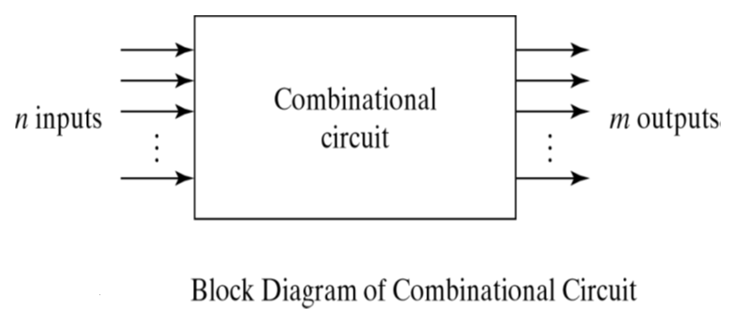
Combinational Circuits
Examples of Combinational Circuits
Addition:
Half Adder (HA).
Full Adder (FA).
BCD(Decimal) Adder.
Subtraction:
Half Subtractor.
Full Subtractor.
Multiplication:
Binary Multipliers.
Comparator:
Magnitude Comparator.
Multiplexers
Demultiplexers
Encoders
Decoders
Converters
Binary to Gray Code
Gray to Binary Code
Binary to BCD Code
What is Combinational Circuits?
A Combinational Circuit is a combination of Logic gates, the output depends upon the current value of the inputs.

Slide 31
Designing Combinational Circuits
In general we have to do following steps:
1.Problem description
2.Input/output of the circuit
3.Define truth table
4.Simplification for each output
5.Draw the circuit

Slide 32
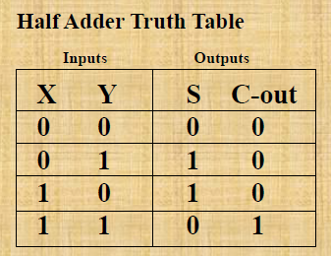
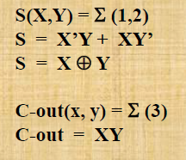
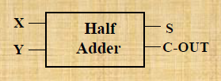
Half Adder
Adding two single-bit binary values, X, Y produces a sum S bit and a carry out C-out bit.
This operation is called half addition and the circuit to realize it is called a half adder.

Slide 33
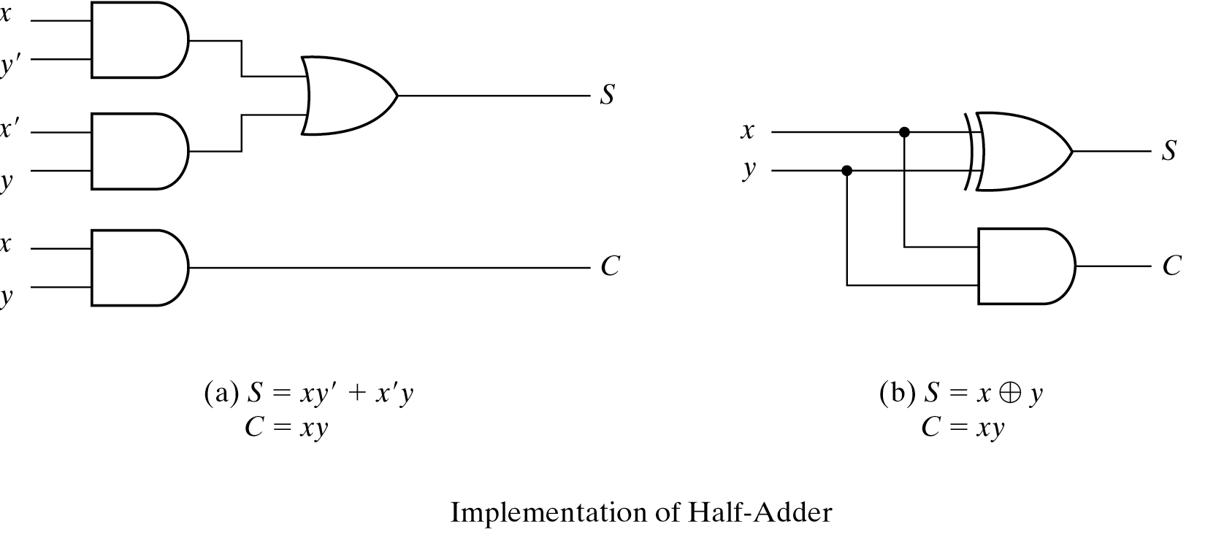
Circuit Implementation

Slide 34
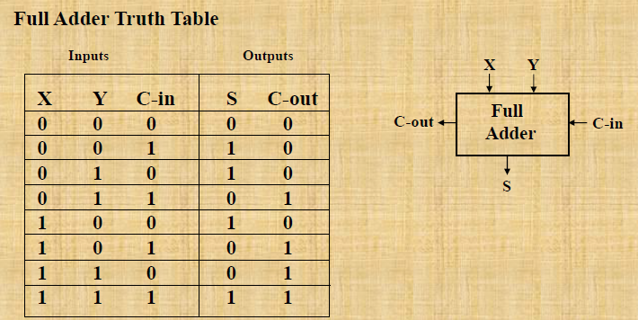
Full Adder
Adding two single-bit binary values, X, Y with a carry input bit C-in produces a sum bit S and a carry out C-out bit.

Slide 35
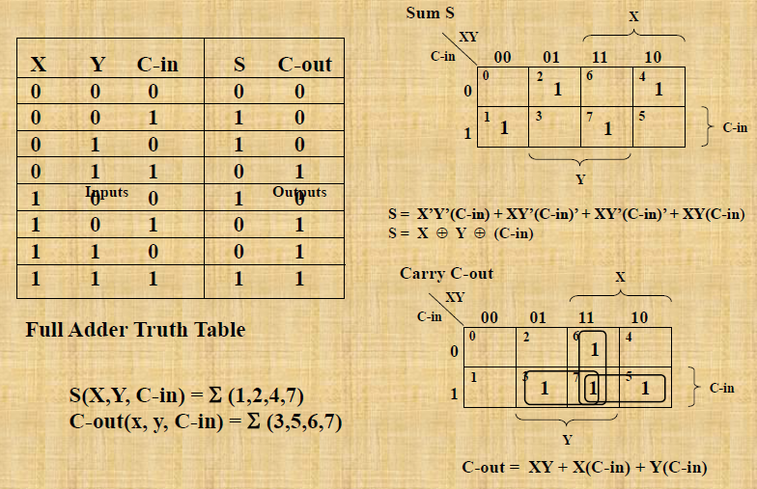

Slide 36
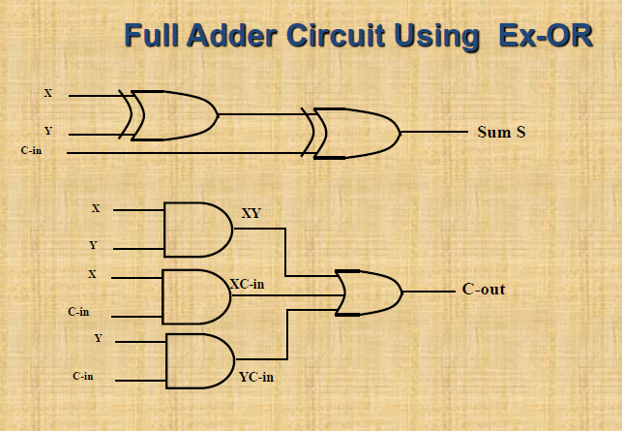
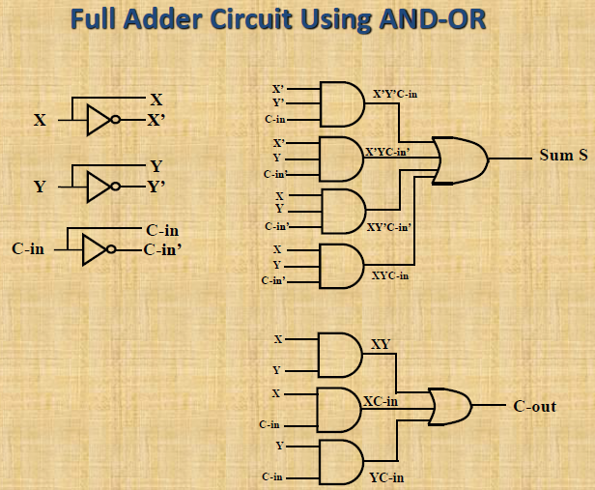

Slide 37
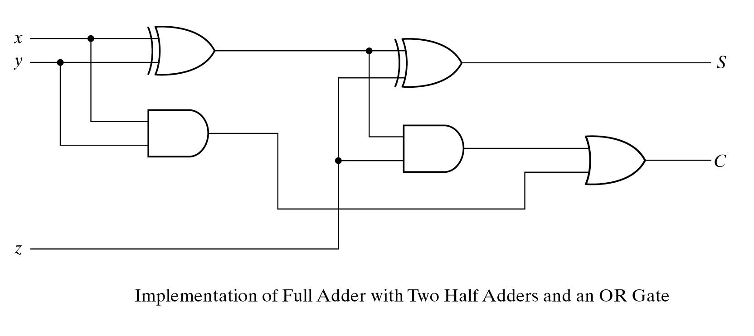
Full Adder Circuit Using two half - Adders

Slide 38
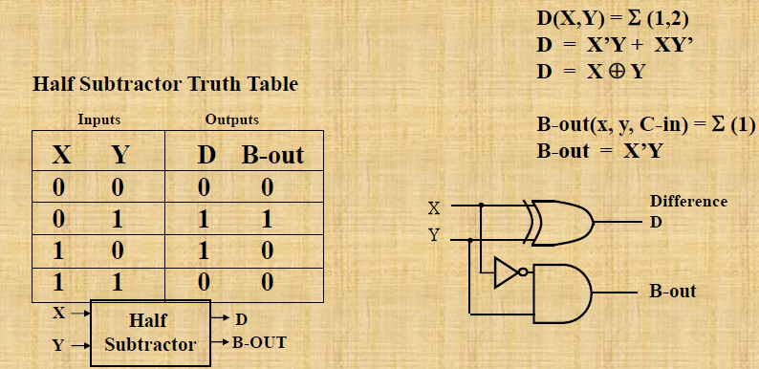
Half Subtractor
Subtracting a single-bit binary value Y from anther X (I.e. X -Y ) produces a difference bit D and a borrow out bit B-out.
This operation is called half subtraction and the circuit to realize it is called a half subtractor.

Slide 39
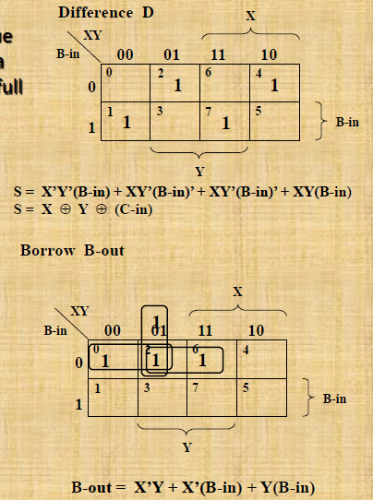
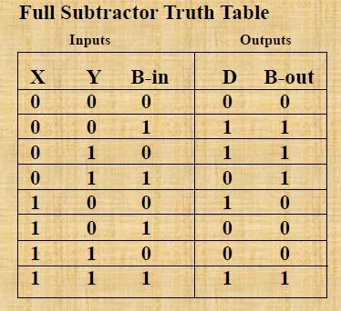
Full Subtractor
Subtracting two single-bit binary values, Y, B-in from a single-bit value X produces a difference bit D and a borrow out B-out bit. This is called full subtraction.

Slide 40
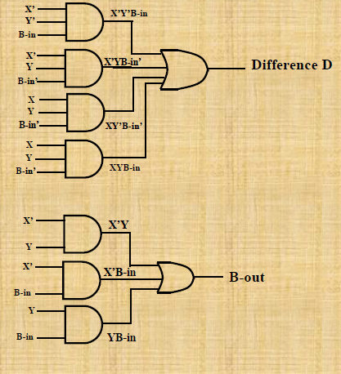
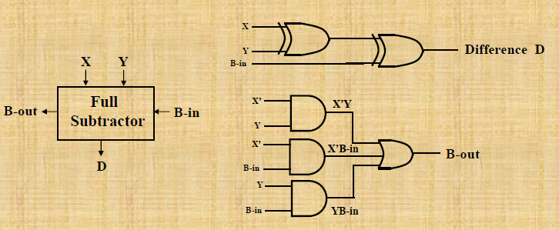
Full Subtractor Circuit Using XOR

Slide 41
Encoder/Decoder Vocabulary
ENCODER- a digital circuit that produces a binary output code depending on which of its inputs are activated.
DECODER- a digital circuit that converts an input binary code into a single numeric output.
ONLY ONE INPUT ACTIVATED AT A TIME
BINARY CODE INPUT
ONLY ONE OUTPUT ACTIVATED AT A TIME
BINARY CODE OUTPUT

Slide 42
Encoder •An encoder is a combinational logic circuit that essentially performs a “reverse” of decoder functions. •An encoder accepts an active level on one of its inputs, representing digit, such as a decimal or octal digits, and converts it to a coded output such as BCD or binary. •Encoders can also be devised to encode various symbols and alphabetic characters. •The process of converting from familiar symbols or numbers to a coded format is called encoding.

Slide 43
ELECTRONIC ENCODER - DECIMAL TO BCD
BCD output
Decimal input
0 0 0 0
0 1 0 1
0 1 1 1
0 0 1 1
7
Decimal
to
BCD
Encoder
5
3
0
Encoders are available in IC form.
This encoder translates from decimal input to BCD output.

Slide 44
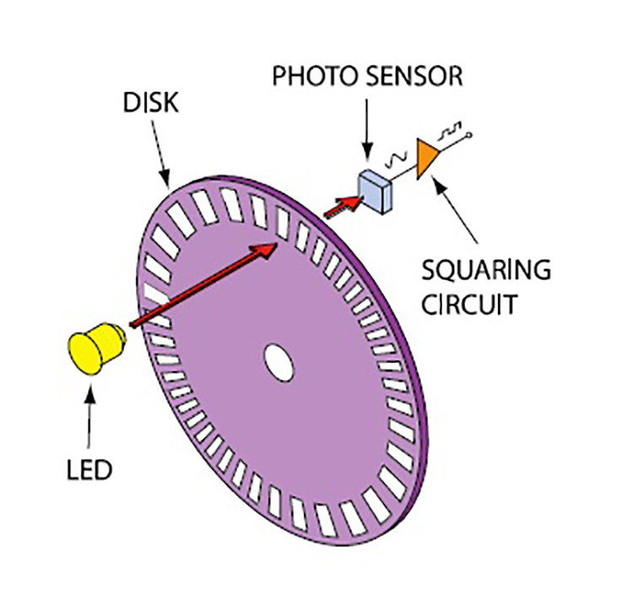

MEGA TORQUE DC PLANETARY GEARED ENCODER SERVO MOTOR 250W 25RPM 18VDC 650KGCM

Slide 45
DECODERS: BCD TO 7-SEGMENT DECODER/DRIVER
BCD input
Decimal output
LED
0 0 0 0
0 0 0 1
0 0 1 0
0 0 1 1
0 1 0 0
BCD-to-
7-Segment
Decoder/
Driver
Electronic decoders are available in IC form.
This decoder translates from BCD to decimal.
Decimals are shown on an 7-segment LED display.
This IC also drives the 7-segment LED display.

Slide 46
Karnaugh Maps (K-Maps)
A visual way to simplify logic expressions
It gives the most simplified form of the expression

Slide 47
Rules to obtain the most simplified expression
Simplification of logic expression using Boolean algebra is awkward because:
it lacks specific rules to predict the most suitable next step in the simplification process
it is difficult to determine whether the simplest form has been achieved.
A Karnaugh map is a graphical method used to obtained the most simplified form of an expression in a standard form (Sum-of-Products or Product-of-Sums).
The simplest form of an expression is the one that has the minimum number of terms with the least number of literals (variables) in each term.
By simplifying an expression to the one that uses the minimum number of terms, we ensure that the function will be implemented with the minimum number of gates.
By simplifying an expression to the one that uses the least number of literals for each terms, we ensure that the function will be implemented with gates that have the minimum number of inputs.

Slide 48
Three-Variable K-Maps

Slide 49
Three-Variable K-Map Examples

Slide 50
Four-Variable K-Maps

Slide 51
Four-Variable K-Maps

Slide 52
Four-Variable K-Maps Examples

Slide 53
Four-Variable K-Maps Examples

Slide 54
Four-Variable K-Maps Examples

Slide 55
Design of combinational digital circuits
Steps to design a combinational digital circuit:
From the problem statement derive the truth table
From the truth table derive the unsimplified logic expression
Simplify the logic expression
From the simplified expression draw the logic circuit
Example: Design a 3-input (A,B,C) digital circuit that will give at its output (X) a logic 1 only if the binary number formed at the input has more ones than zeros.

Slide 56
Design of combinational digital circuits (Cont.)
Example: Design a 4-input (A,B,C,D) digital circuit that will give at its output (X) a logic 1 only if the binary number formed at the input is between 2 and 9 (including).

Slide 57
Design of combinational digital circuits (Example)
Example: Design a 4-input (A,B,C,D) digital circuit that will give at its output (X) a logic 1 only if there more ones than zeros in the binary number formed at the input.

Slide 58
Flip Flops

Slide 59
Introduction
A sequential circuit consists of a feedback path, and employs some memory elements.
Combinational outputs
Memory outputs
Combinational logic
Memory elements
External inputs
Sequential circuit = Combinational logic + Memory Elements

Slide 60
Comparison between combinational circuit and sequential circuit
Aspect | Combinational Circuit | Sequential Circuit
Functionality | Output depends only on current inputs | Output depends on current inputs and previous states
Feedback | No feedback path | Contains feedback loops
State | No internal state storage | Contains internal state storage
Timing | Operates in parallel | Operates sequentially
Timing Constraints | No timing constraints between inputs and outputs | Timing constraints based on clock signal
Design Complexity | Generally simpler to design | Can be more complex to design
Examples | Adders, Multiplexers | Flip-flops, Counters, Shift Registers
Memory Usage | No memory elements required | Requires memory elements for state storage
Applications | Arithmetic and logic operations | Digital memory, Finite state machines
Synchronous Operation | Not applicable | Depends on clock signal for operation
Asynchronous Operation | Not applicable | Possible, but may lead to timing hazards
Output Changes | Immediately upon input change | Delayed response based on clock cycles
Dependency | Output depends only on present input values | Output depends on past and present input values

Slide 61
Introduction
There are two types of sequential circuits:
synchronous: outputs change only at specific time
asynchronous: outputs change at any time
Multivibrator: a class of sequential circuits. They can be:
bistable (2 stable states)
monostable or one-shot (1 stable state)
astable (no stable state)
Bistable logic devices: latches and flip-flops.
Latches and flip-flops differ in the method used for changing their state.

Slide 62
Memory Elements
Memory element: a device which can remember value indefinitely, or change value on command from its inputs.
Characteristic table:
Memory element
Q
command
stored value
Q(t): current state
Q(t+1) or Q⁺: next state

Slide 63
Memory Elements
Memory element with clock. Flip-flops are memory elements that change state on clock signals.
Clock is usually a square wave.
Memory element
Q
command
stored value
clock
Positive pulses
Positive edges
Negative edges

Slide 64
Memory Elements
Two types of triggering/activation:
pulse-triggered
edge-triggered
Pulse-triggered
latches
ON = 1, OFF = 0
Edge-triggered
flip-flops
positive edge-triggered (ON = from 0 to 1; OFF = other time)
negative edge-triggered (ON = from 1 to 0; OFF = other time)

Slide 65
S-R Latch
Complementary outputs: Q and Q'.
When Q is HIGH, the latch is in SET state.
When Q is LOW, the latch is in RESET state.
For active-HIGH input S-R latch (also known as NOR gate latch),
R=HIGH (and S=LOW) a RESET state
S=HIGH (and R=LOW) a SET state
both inputs LOW a no change
both inputs HIGH a Q and Q' both LOW (invalid)!

Slide 66
S-R Latch
Characteristics table for active-high input S-R latch:
S
R
Q
Q'

Slide 67
S-R Latch
Active-HIGH input S-R latch
1
0
1
0
0
R
1
0
1
0
Q
0
Q'
0
0
0
1
1
1
0
0
0
1
S

Slide 68
Gated D Latch
Make R input equal to S' → gated D latch.
D latch eliminates the undesirable condition of invalid state in the S-R latch.
D
Q
D
EN
Q
Q'
EN
Q'

Slide 69
Gated D Latch
When EN is HIGH,
D=HIGH → latch is SET
D=LOW → latch is RESET
Hence when EN is HIGH, Q ‘follows’ the D (data) input.
Characteristic table:
When EN=1, Q(t+1) = D

Slide 70
Latch Circuits: Not Suitable
Latch circuits are not suitable in synchronous logic circuits.
When the enable signal is active, the excitation inputs are gated directly to the output Q. Thus, any change in the excitation input immediately causes a change in the latch output.
The problem is solved by using a special timing control signal called a clock to restrict the times at which the states of the memory elements may change.
This leads us to the edge-triggered memory elements called flip-flops.

Slide 71
Edge-Triggered Flip-flops
Flip-flops: synchronous bistable devices
Output changes state at a specified point on a triggering input called the clock.
Change state either at the positive edge (rising edge) or at the negative edge (falling edge) of the clock signal.
Clock signal
Positive edges
Negative edges

Slide 72
Edge-Triggered Flip-flops
S-R, D and J-K edge-triggered flip-flops. Note the “>” symbol at the clock input.
S
C
R
Q
Q'
D
C
Q
Q'
J
C
K
Q
Q'
Positive edge-triggered flip-flops
S
C
R
Q
Q'
D
C
Q
Q'
J
C
K
Q
Q'
Negative edge-triggered flip-flops

Slide 73
S-R Flip-flop
S-R flip-flop: on the triggering edge of the clock pulse,
S=HIGH (and R=LOW) a SET state
R=HIGH (and S=LOW) a RESET state
both inputs LOW a no change
both inputs HIGH a invalid
Characteristic table of positive edge-triggered S-R flip-flop:
X = irrelevant (“don’t care”)
↑ = clock transition LOW to HIGH

Slide 74
S-R Flip-flop
It comprises 3 parts:
a basic NAND latch
a pulse-steering circuit
a pulse transition detector (or edge detector) circuit
The pulse transition detector detects a rising (or falling) edge and produces a very short-duration spike.

Slide 75
S-R Flip-flop
The pulse transition detector.
S
Q
Pulse transition detector
CLK
Q'
R
CLK'
CLK'
CLK
CLK*
CLK
CLK*
CLK
CLK
CLK'
CLK'
CLK*
CLK*
Positive-going transition
(rising edge)
Negative-going transition
(falling edge)

Slide 76
D Flip-flop
D flip-flop: single input D (data)
D=HIGH a SET state
D=LOW a RESET state
Q follows D at the clock edge.
Convert S-R flip-flop into a D flip-flop: add an inverter.
D
S
C
R
Q
Q'
CLK
↑ = clock transition LOW to HIGH
A positive edge-triggered D flip-flop formed with an S-R flip-flop.

Slide 77
J-K Flip-flop
J-K flip-flop: Q and Q' are fed back to the pulse-steering NAND gates.
No invalid state.
Include a toggle state.
J=HIGH (and K=LOW) a SET state
K=HIGH (and J=LOW) a RESET state
both inputs LOW a no change
both inputs HIGH a toggle

Slide 78
J-K Flip-flop
J-K flip-flop.
Characteristic table.
J
Q
Pulse transition detector
CLK
Q'
K
Q(t+1) = J.Q' + K'.Q

Slide 79
T Flip-flop
T flip-flop: single-input version of the J-K flip flop, formed by tying both inputs together.
Characteristic table.
T
T
Q
J
C
K
Q
Q'
Pulse transition detector
CLK
CLK
Q'
Q(t+1) = T.Q' + T'.Q

Slide 80
Registers and Counters

Slide 81
Registers
Register – a collection of binary storage elements
In theory, a register is sequential logic, i.e. can be defined by a state table
But more often, we think of a register as an array of n flip flops (possibly with some extra gates) that store a vector of n binary bits
Used to perform simple data storage, movement, manipulation and processing operations (e.g. load, increment, shift, add, etc.)
The computer processes data by performing operations on registers, e.g. ADD A, B where A and B are say 32-bit registers

Slide 82
Register/Counter Design Methods
Classical Direct Approach: From State Diagram
Design individual cells using the state diagram/state table model and combine them into a register
Problem: for n large → large number of states → state diagram/state table model is often not feasible!- Pentium has 64-bit data registers (states = ?)
Alternative (Ad hoc?) Approach: (similar to iterative design method in combinational logic)
Add predefined combinational circuits to a register to perform desired functions
Example: To count up, connect the register flip-flop outputs to an incrementer

Slide 83
Shift Registers
Shift Registers move data laterally (←→) within the n-bit register toward its MSB or LSB position
In the simplest case, the shift register is simply a set of D flip-flops connected in a row like this:
Data input, In, is called a serial input or the shift right input.
Data output, Out, is often called the serial output (=D).
The vector (A, B, C, D) is called the parallel output.
Serial
Serial
D
Shift Left
Shift Right

Slide 84
Shift Registers
Behavior of the 4- stage serial shift
register
Initial register state just before the first clock pulse arrives
T1: State after the first pulse and before the second
Initially unknown states are denoted
by “?”
Complete the last three rows of the table
In
A
B
C
Out
D
Q
D
Q
D
Q
D
Q
Clock CP
CP
In
A
B
C
D, Out
0
?
?
?
?
After 4
Clock
Pulses:
T1
1
0
?
?
?
T2
1
1
0
?
?
T3
0
1
1
0
?
T4
1
0
1
1
0
2. Serial I/P
starts
appearing
Serially
at O/P
T5
1
1
T6
1
1
1. Serial I/P
Appears
in parallel
In register
0
Problem: Serial loading takes n clock cycles-
Possible Improvements: Load in parallel?
Notes:
ROW T4: 10110
Row T5: 11011
Row T6: 11101

Slide 85
Shift Register Applications
Delaying:
→ input sequence appears at output after n-clock cycles
Parallel to serial (and Serial to parallel) conversion
Arithmetic:
→ Shifting one bit to the right causes dividing by ?
→ Shifting one bit to the left (inserting 0s) causes multiplying by ?
Lateral Shift
n
Parallel Load
n–bit
Shift Register
101100000010110
n–bit
Shift Register
Serial Link
e.g. Ethernet
Parallel Read
n
Notes:
ROW T4: 10110
Row T5: 11011
Row T6: 11101

Slide 86
Counters
A counter is a register that has its parallel outputs "count" through a specific state sequence
Sequences can be binary, BCD, etc.
Counting can be up, down
A modulo-n counter goes through values 0,1,2, …, (n-1)
e.g. modulo-10 up counter counts: 0,1,…9
Some Applications:
Frequency division
Event counting
Timers
ABC (LSB)
000
001
010
011
100
101
000
001
This is a modulo-?
Up/Down? Counter
Successive
Clock
Pulses

Slide 87
Implementing Counters Two Basic Approaches
Asynchronous (Ripple) Counters
The external clock is connected to the flip-flop clock input of the LSB bit flip-flop (first counter stage)
For all subsequent stages, the clock input is derived from the output of the preceding stage,
i.e. circuit is not truly synchronous- no common clock to all stages
Advantage:
- Simpler circuit, lower power consumption
Disadvantages:
- Output change delayed further for each stage toward the MSB
- Max clock frequency limited by this ripple propagation delay

Slide 88
Ripple Up Counter 2-bit counter (modulo 4: Counts: 00,01,10,11
How does it work?
At the positive edge on the external clock input of A, A toggles
The clock input for flip- flop B is the complemented output of flip-flop A
When flip A changes from 1 to 0, there is a positive edge on the clock input of B causing B to complement→ it toggles
LSB
D
A
f/2 Hz
External
Clock, f Hz
C_{R}
2 Toggling stages- each is modulo-2 i.e. divide by 2
Q (i-1)
to Clk (i)
D
B
f/4 Hz
C_{R}
Reset
00
01
10
11
CP
QA
0 1 0 1 0
Toggle
Every CP
+ive
edges
On Q
QB
0 0 1 1 0 0
Toggle
Every 2 CPs
0
1
2
3
0
1

Slide 89
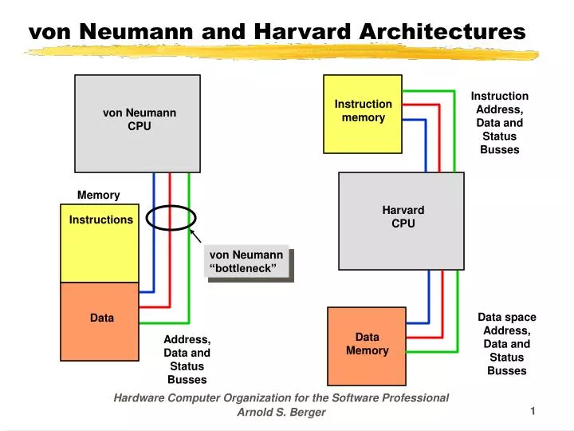
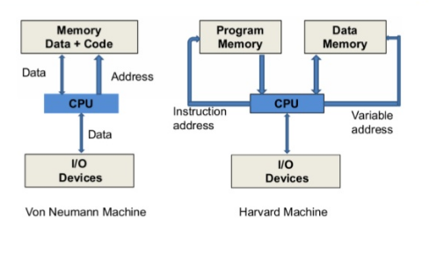

Slide 90
Difference between Von Neumann and Harvard Architecture
VON NEUMANN ARCHITECTURE | HARVARD ARCHITECTURE
It is ancient computer architecture based on stored program computer concept. | It is modern computer architecture based on Harvard Mark I relay based model.
Same physical memory address is used for instructions and data. | Separate physical memory address is used for instructions and data.
There is common bus for data and instruction transfer. | Separate buses are used for transferring data and instruction.
Two clock cycles are required to execute single instruction. | An instruction is executed in a single cycle.
It is cheaper in cost. | It is costly than Von Neumann Architecture.
CPU can not access instructions and read/write at the same time. | CPU can access instructions and read/write at the same time.
It is used in personal computers and small computers. | It is used in micro controllers and signal processing.

Slide 91
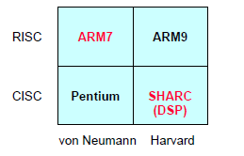
RISC vs. CISC
Reduced Instruction Set Computer (RISC)
Compact, uniform instructions
facilitate pipelining
More lines of code
large memory footprint
Allow effective compiler optimization
Complex Instruction Set Computer (CISC)
Many addressing modes and long instructions
High code density
Often require manual optimization of assembly code for embedded systems

Slide 92
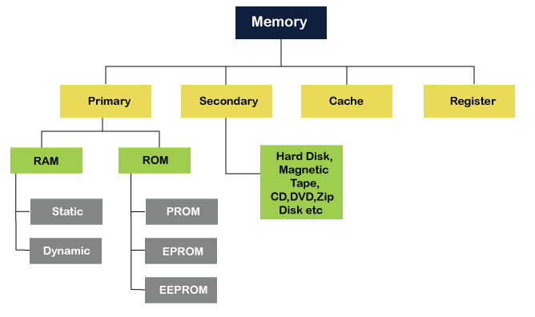
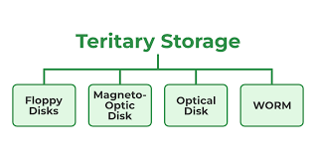
Memory Classification
Refer link for additional description
https://www.javatpoint.com/classification-of-memory

Slide 93
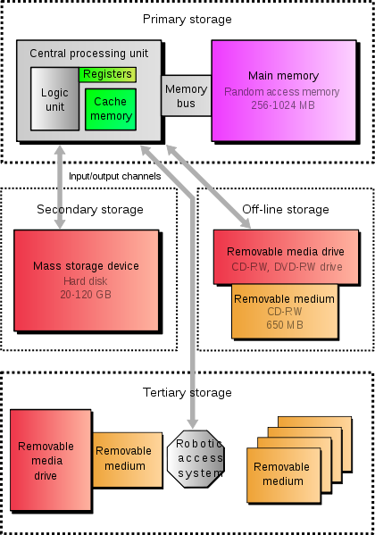
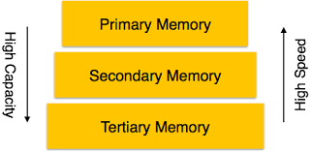
Memory Types
Secondary Memory
Primary Memory
RAM
SRAM
DRAM
ROM
PROM
EPROM
Hybrid
EEPROM
NVRAM
Flash Memory
Cache Memory
Virtual Memory

Slide 94
Primary Memory
Primary storage (or main memory or internal memory), often referred to simply as memory, is the only one directly accessible to the CPU. The CPU continuously reads instructions stored there and executes them as required.
Main memory is directly or indirectly connected to the CPU via a memory bus. It is actually two buses (not on the diagram): an address bus and a data bus. The CPU firstly sends a number through an address bus, a number called memory address, that indicates the desired location of data. Then it reads or writes the data itself using the data bus.
It is divided into RAM and ROM.

Slide 95
RAM
The RAM family includes two important memory devices: static RAM (SRAM) and dynamic RAM (DRAM). The primary difference between them is the lifetime of the data they store.
SRAM retains its contents as long as electrical power is applied to the chip. If the power is turned off or lost temporarily, its contents will be lost forever.
DRAM, on the other hand, has an extremely short data lifetime-typically about four milliseconds. This is true even when power is applied constantly. DRAM controller is used to refresh the data before it expires, the contents of memory can be kept alive for as long as they are needed. So DRAM is as useful as SRAM after all.

Slide 96
Types of RAM
Double Data Rate synchronous dynamic random access memory or also known as DDR1 SDRAM is a class of memory integrated circuits used in computers. The interface uses double pumping (transferring data on both the rising and falling edges of the clock signal) to lower the clock frequency. One advantage of keeping the clock frequency down is that it reduces the signal integrity requirements on the circuit board connecting the memory to the controller.

Slide 97
DDR2, DDR and SDRAM
DDR2 memory is fundamentally similar to DDR SDRAM. Still, while DDR SDRAM can transfer data across the bus two times per clock, DDR2 SDRAM can perform four transfers per clock. DDR2 uses the same memory cells, but doubles the bandwidth by using the multiplexing technique.
The DDR2 memory cell is still clocked at the same frequency as DDR SDRAM and SDRAM cells, but the frequency of the input/output buffers is higher with DDR2 SDRAM (as shown in Fig. on next Slide). The bus that connects the memory cells with the buffers is twice wider compared to DDR. Thus, the I/O buffers perform multiplexing: the data is coming in from the memory cells along a wide bus and is going out of the buffers on a bus of the same width as in DDR SDRAM, but of a twice bigger frequency. This allows to increase the memory bandwidth without increasing the operational frequency.

Slide 98
Types of ROM
Memories in the ROM family are distinguished by the methods used to write new data to them (usually called programming), and the number of times they can be rewritten. This classification reflects the evolution of ROM devices from hardwired to programmable to erasable-and-programmable. A common feature is their ability to retain data and programs forever, even during a power failure. The contents of the ROM had to be specified before chip production, so the actual data could be used to arrange the transistors inside the chip.

Slide 99
PROM
One step up from the masked ROM is the PROM (programmable ROM), which is purchased in an unprogrammed state. If you were to look at the contents of an unprogrammed PROM, the data is made up entirely of 1's. The process of writing your data to the PROM involves a special piece of equipment called a device programmer. The device programmer writes data to the device one word at a time by applying an electrical charge to the input pins of the chip. Once a PROM has been programmed in this way, its contents can never be changed. If the code or data stored in the PROM must be changed, the current device must be discarded. As a result, PROMs are also known as one-time programmable (OTP) devices.

Slide 100
EPROM
An EPROM (erasable-and-programmable ROM) is programmed in exactly the same manner as a PROM. However, EPROMs can be erased and reprogrammed repeatedly. To erase an EPROM, you simply expose the device to a strong source of ultraviolet light. (A window in the top of the device allows the light to reach the silicon.) By doing this, you essentially reset the entire chip to its initial-unprogrammed-state. Though more expensive than PROMs, their ability to be reprogrammed makes EPROMs an essential part of the software development and testing process.

Slide 101
Hybrid types
As memory technology has matured in recent years, the line between RAM and ROM has blurred. Now, several types of memory combine features of both. These devices do not belong to either group and can be collectively referred to as hybrid memory devices. Hybrid memories can be read and written as desired, like RAM, but maintain their contents without electrical power, just like ROM. Two of the hybrid devices, EEPROM and flash, are descendants of ROM devices. These are typically used to store code. The third hybrid, NVRAM, is a modified version of SRAM. NVRAM usually holds persistent data.

Slide 102
EEPROMS are electrically-erasable-and-programmable. Internally, they are similar to EPROMs, but the erase operation is accomplished electrically, rather than by exposure to ultraviolet light. Any byte within an EEPROM may be erased and rewritten. Once written, the new data will remain in the device forever-or at least until it is electrically erased. The primary tradeoff for this improved functionality is higher cost, though write cycles are also significantly longer than writes to a RAM. So you wouldn't want to use an EEPROM for your main system memory.

Slide 103
Flash memory combines the best features of the memory devices described thus far. Flash memory devices are high density, low cost, nonvolatile, fast (to read, but not to write), and electrically reprogrammable. These advantages are overwhelming and, as a direct result, the use of flash memory has increased dramatically in embedded systems. From a software viewpoint, flash and EEPROM technologies are very similar. The major difference is that flash devices can only be erased one sector at a time, not byte-by-byte. Typical sector sizes are in the range 256 bytes to 16KB. Despite this disadvantage, flash is much more popular than EEPROM and is rapidly displacing many of the ROM devices as well.

Slide 104
The third member of the hybrid memory class is NVRAM (non-volatile RAM). Nonvolatility is also a characteristic of the ROM and hybrid memories discussed previously. However, an NVRAM is physically very different from those devices. An NVRAM is usually just an SRAM with a battery backup. When the power is turned on, the NVRAM operates just like any other SRAM. When the power is turned off, the NVRAM draws just enough power from the battery to retain its data. NVRAM is fairly common in embedded systems. However, it is expensive-even more expensive than SRAM, because of the battery-so its applications are typically limited to the storage of a few hundred bytes of system-critical information that can't be stored in any better way.

Slide 105
Cache Memory
A CPU cache is a cache used by the central processing unit of a computer to reduce the average time to access memory. The cache is a smaller, faster memory which stores copies of the data from the most frequently used main memory locations. As long as most memory accesses are cached memory locations, the average latency of memory accesses will be closer to the cache latency than to the latency of main memory.
When the processor needs to read from or write to a location in main memory, it first checks whether a copy of that data is in the cache. If so, the processor immediately reads from or writes to the cache, which is much faster than reading from or writing to main memory

Slide 106
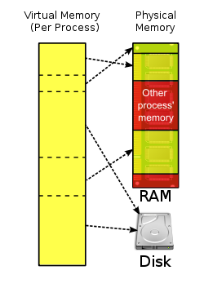
Virtual Memory
It is a computer system technique which gives an application program the impression that it has contiguous working memory (an address space), while in fact it may be physically fragmented and may even overflow on to disk storage.
computer operating systems generally use virtual memory techniques for ordinary applications, such as word processors, spreadsheets, multimedia, players accounting, etc., except where the required hardware support (memory management unit) is unavailable or insufficient.

Slide 107
Thank You

